Slide 1
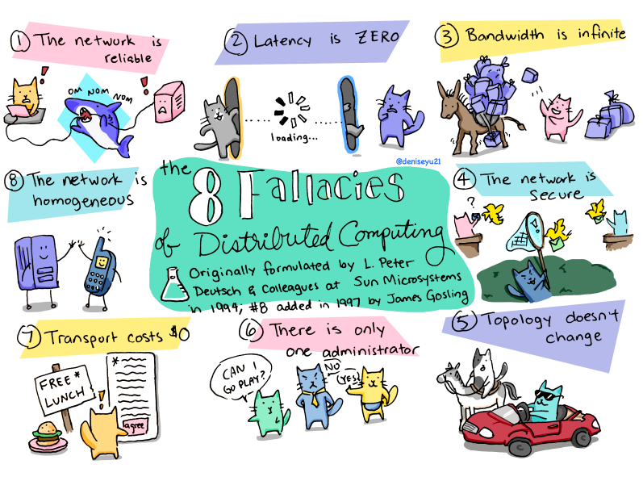
Leslie Lamport papers
Time, Clocks, and the Ordering of Events in a Distributed System
How to Make a Multiprocessor Computer That Correctly Executes Multiprocess Programs
The Byzantine Generals' Problem
Distributed Snapshots: Determining Global States of a Distributed System
The Part-Time Parliament
Paxos algorithm for consensus.
Bakery algorithm for mutual exclusion of multiple threads in a computer system that require the same resources at the same time.
Chandy-Lamport algorithm for the determination of consistent global states (snapshot).
Lamport signature, one of the prototypes of the digital signature.

Slide 2
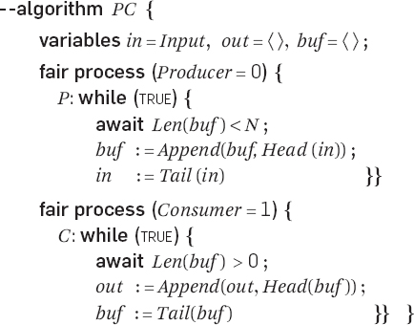
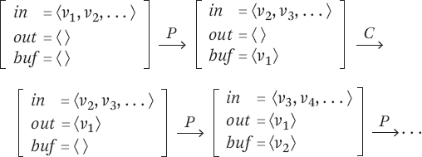
Producer-Consumer Synchronization
An execution of the FIFO queue in standard model.
Producer-Consumer: specification ✓
Bounded FIFO queue: implementation ? (prove its correct)
A state predicate is an invariant iff it is true in every state of every execution.

Slide 3

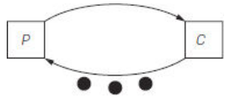
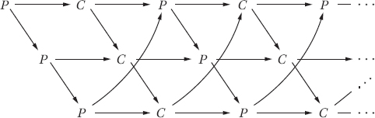
Producer-Consumer Synchronization
2
3
2
event
0
An event history for the FIFO queue with N = 3.
v0
v0
v3
v3
2
2
2
2
2
tokens on any cycle
remain constant
process 1:
Generalizing to marked graph synchronization.
process 2:
v2
v2
FIFO queue as N process system.
Marked graph: Direct graph with edge-marking w/ finite set of tokens.
Node fire: remove 1 token from each input + add 1 to each output
Firing sequence: fire until no node can fire
Producer-Consumer: deterministic
Mutual exclusion: non-deterministic (race w/ arbiter)
(arbiter decides which of 2 events happened first)

Slide 4
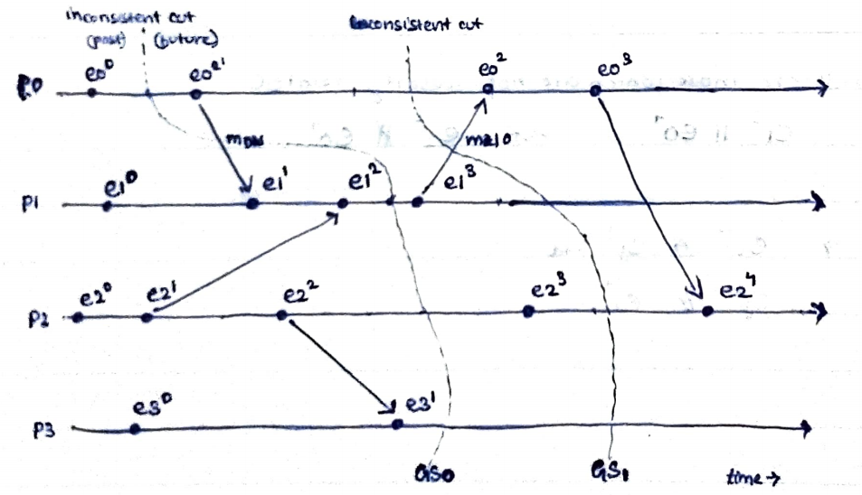
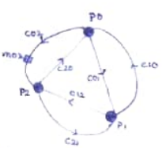
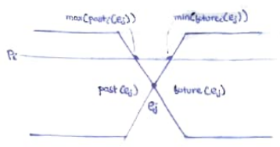
Event History
Pictures of event histories were first used to describe distributed systems.
No global shared clock.
Communication delay unpredictable.
p: async process (i)
c: channel, unidirectional (ij)
m: message (k)
Causality: message must be sent before it was received.
Within a process, all events causally follow.
Send & receive of a message causally follow.
Concurrent events: those not causally related.
Process state: events in process
Channel state: message sent but not yet received
Global state: process states U channel states
- consistent: a message not sent is neither in channel or recieved
- transitless: all channels are empty (strong: consistent + transitless)
past(e): all events that causally happen before e
max_past(e): events that happen just before e (each process)
min_future(e): events that happen just after e
process 0
channel
event 0
recieve
internal
send
message

Slide 5
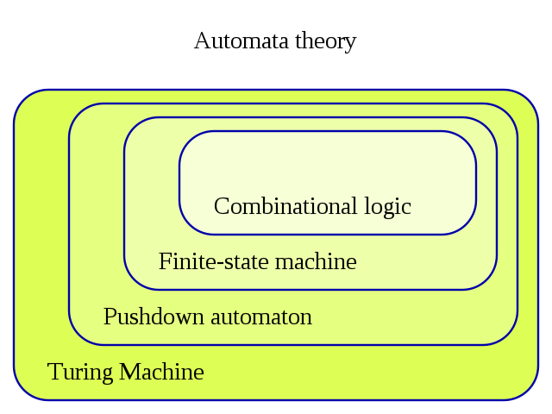
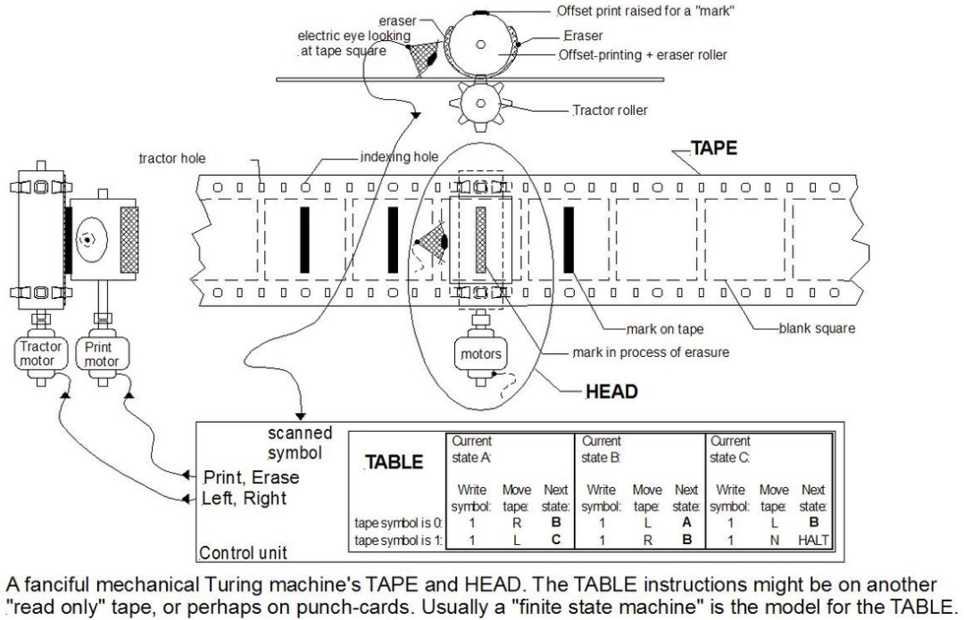
Standard Model
Execution is represented as a sequence of atomic transitions states.
Event history describes all sequences of states that represent executions in the standard model.
The executions are not inherently different, but artifacts of the standard model. It requires concurrent executions of two operations to be modeled as ocurring in an order.
The problem of implementing a distributed system can often be viewed as that of maintaining a global invariant even though different processes may have incompatible views of what the current state is.
The standard model provides the most practical way to reason about invariance.

Slide 6
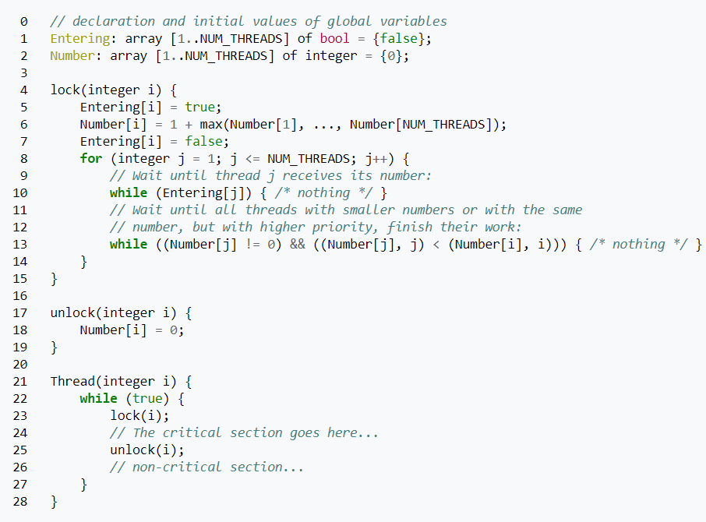
Mutual Exclusion
Synchronizing N processes, each with a section of code called its critical section.
Safety: no 2 ciritical section executed concurrently.
Liveness: some process eventually executes its CS.
Assumption: "process fairness" every process eventually takes a step.
BAKERY ALGORITHM
First to implement mut-ex without any lower level mut-ex.
Customers take tickets, and lowest number ticket is served first.
Each process computes its ticket number from others' tickets.
Proof does not require read/write of entire number be atomic.

Slide 7

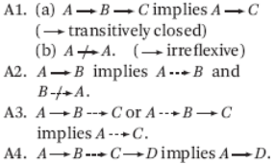

Two-arrow Model
memory barrier
a
a
interprocess communication
For A4:
A: data = 10
B: sent = T
C: if (sent)
D: read data
A
B
B
A
A
B
C
A1
A2
A
B
B
C
B
A
A3
A
e
e
f
f
SYNC fail
C
D
B
A
A4
A
B
e
f
SYNC pass
Two-arrow model for event history
B
A
D
C
SYNC fail

Slide 8
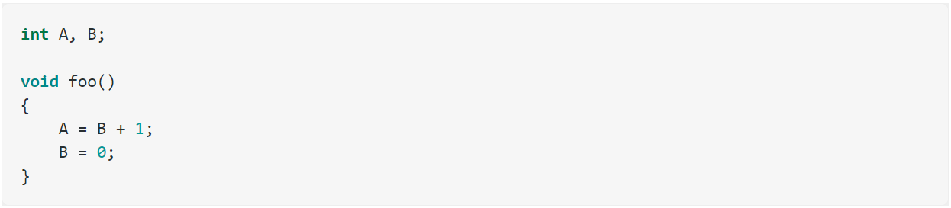
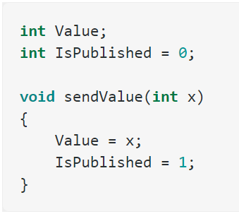
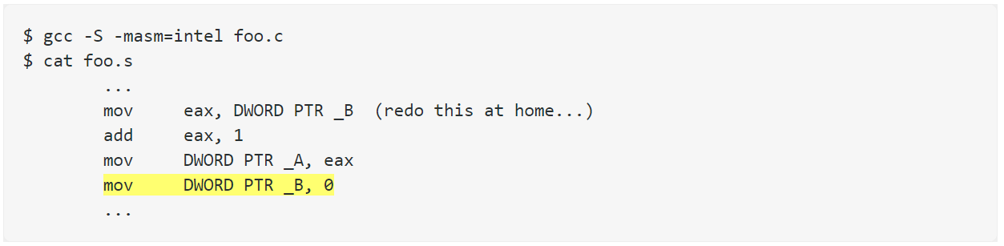
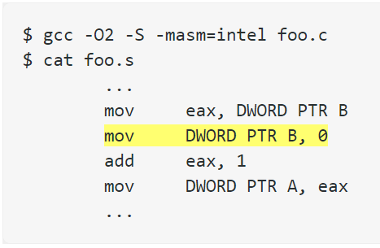
Compiler Instruction Reordering
RULE: Thou shalt not modify the behavior of a single-threaded program.
recvValue() can read garbage value.
Problematic with Lock-free programming.
Use C++11 atomics.

Slide 9
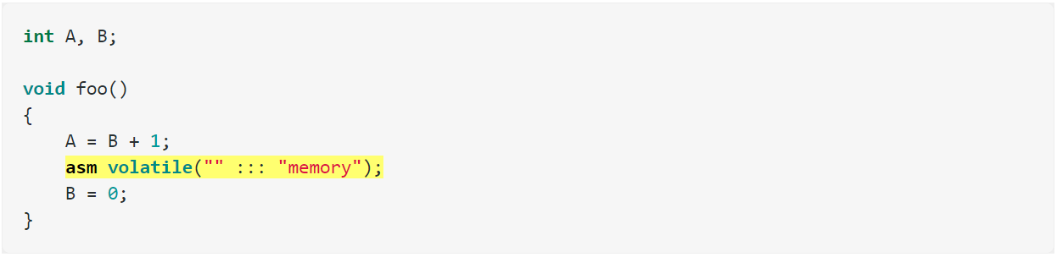
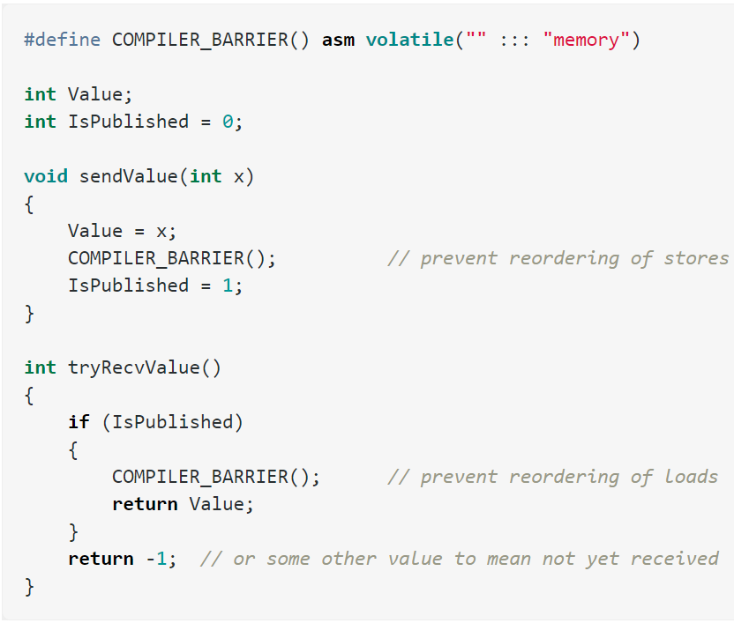
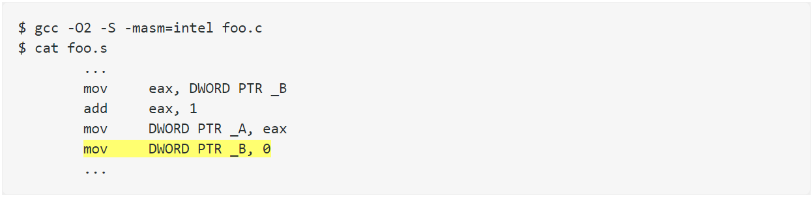
Explicit Compiler Barrier
recvValue() now works.

Slide 10
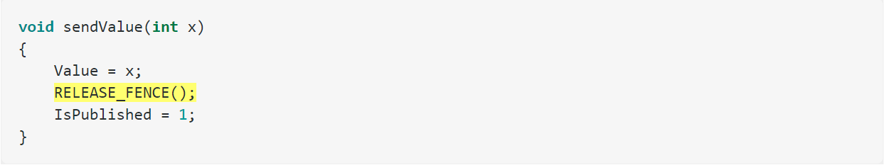
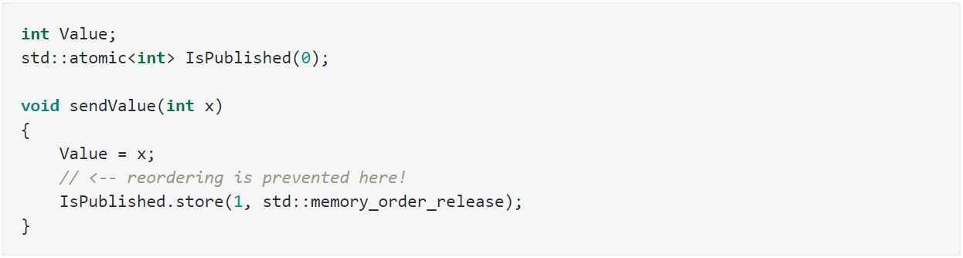
Implied Compiler Barrier
CPU fence instructions also prevent compiler reordering.
C++11 atomic instructions prevent compiler reordering.

Slide 11
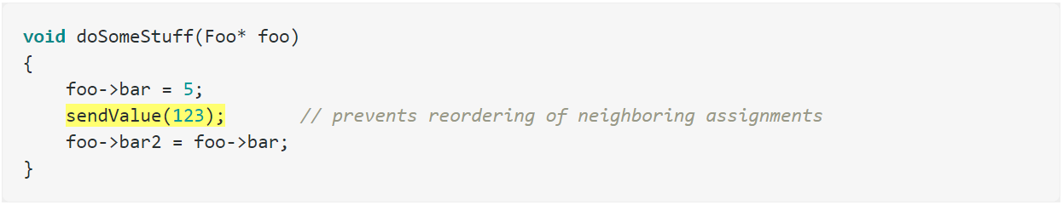
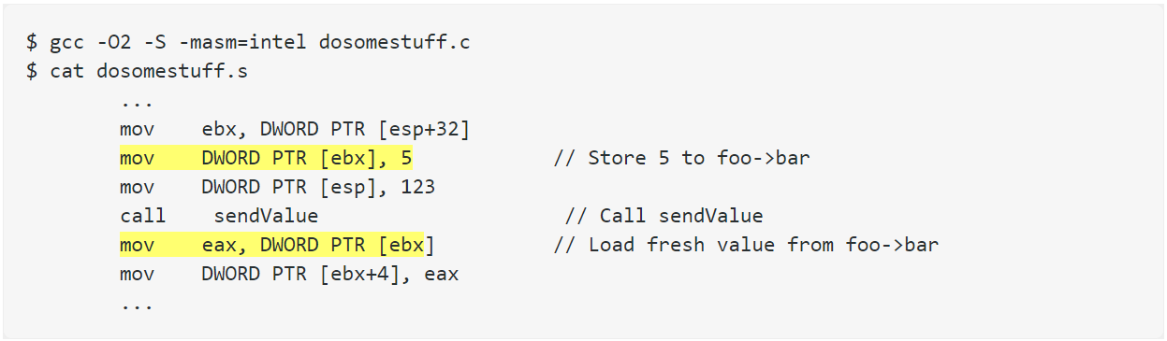
Implied Compiler Barrier
Except inline, pure functions a call to an external function is even stronger than a compiler barrier, since the compiler has no idea what the function’s side effects will be.

Slide 12
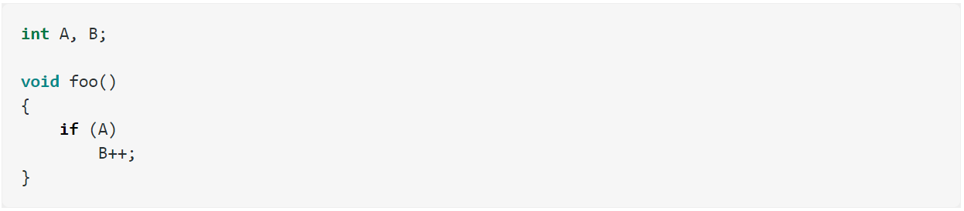
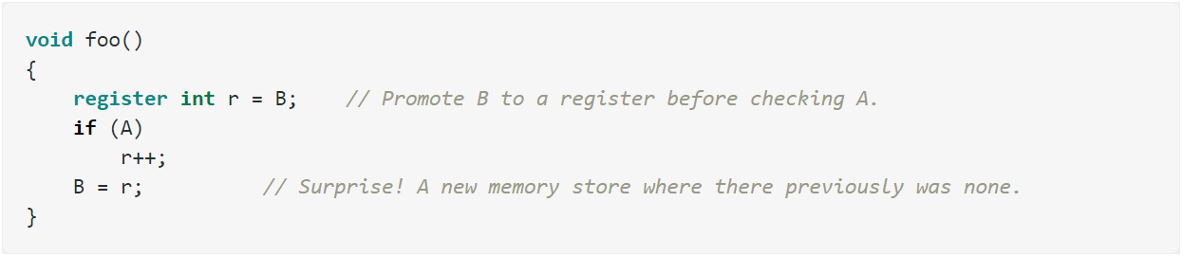
Register replacement
What if multiple increments happen on regitser before return? Overwrite.
C++11 doesn't avoids register replacement on shared memory locations.

Slide 13

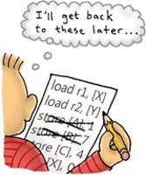

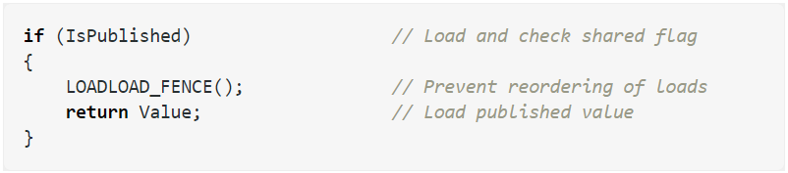


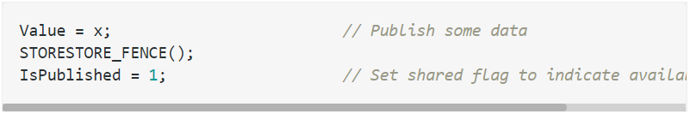
Types of Memory Barrier
lwsync:
#LoadLoad, #StoreStore, #LoadStore
#StoreLoad is unique: a = b = 0
#StoreLoad acts as a full memory fence
DataDependency is a barrier too.

Slide 14
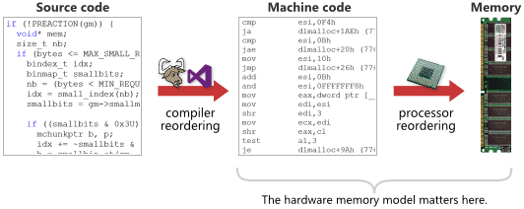
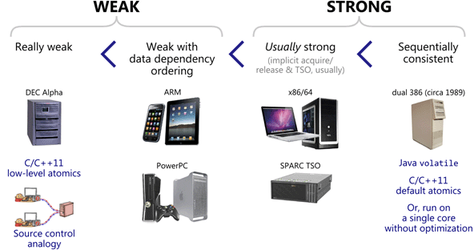

Weak vs. Strong Memory models

Slide 15
Temporal Logic
Propositional Logic
A logic for specifying properties over time.
A proposition is a declarative sentence that is either true or false, but not both.
GP(Prior invents TL)
It will always be the case that Prior invented TL.
It is dark, it was light, and it will be light again.
I will keep trying until I succeed.
Ever since Mia left home, Joe has been unhappy and has been drinking until losing consciousness.
Every time when a message is sent, an acknowledgment of receipt will eventually be returned, and the message will not be marked ‘sent’ before an acknowledgment of receipt is returned.
p → q
If it is raining, then the home team wins.
If the home team does not win, then it is not raining.
If the home team wins, then it is raining.
If it is not raining, then the home team does not win.
p : You have the flu.
q : You miss the final examination.
r : You pass the course.
p → q, ¬q ↔ r, q → ¬r, p ∨ q ∨ r
(p → ¬r) ∨ (q → ¬r), (p ∧ q) ∨ (¬q ∧ r)
¬p ← ¬q
dark ∧ P(light) ∧ F(light)
p ← q
try U succeed
¬p → ¬q
(Joe unhappy ∧ (Joe drinks U ¬(Joe conscious))) S (Mia leaves)
G(Sent → (¬MarkedSent U AckReturned))
Amir Pnueli in 1977
Goranko, Valentin and Antje Rumberg, "Temporal Logic", The Stanford Encyclopedia of Philosophy (Summer 2020 Edition), Edward N. Zalta (ed.), URL = <https://plato.stanford.edu/archives/sum2020/entries/logic-temporal/>.
Discrete Mathematics and Its Applications: With Combinatorics and Graph Theory
Rosen, K.H.; Krithivasan, K.; (2012)

Slide 16
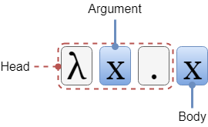
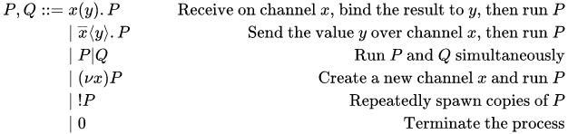

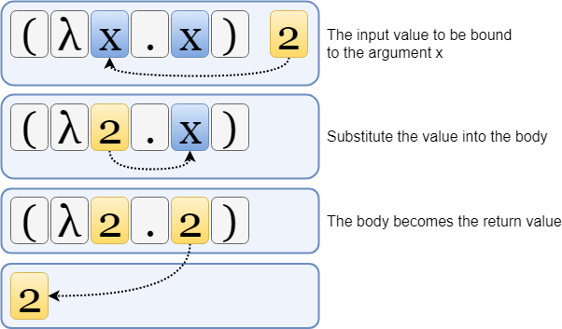
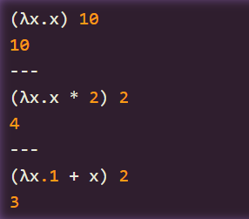



π-calculus
Lambda Calculus
Formal foundation of concurrent programming.
Express computation as function abstraction and application w/ binding & substitution.
https://www.simonholywell.com/post/the-lambda-calculus/

